Slide 1

PUNJAB EXCISE
ONLINE MANAGEMENT SYSTEM FOR DISTILLRIES

Slide 2
CREATING ACCOUNT FOR
Manufacturer Account Registration
LICENSE OR RENEWAL
/
PRODUCTION REPORT

Slide 3
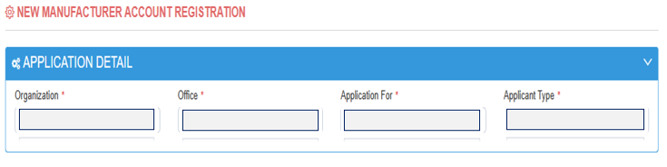


LICENSE NEW/RENEWAL
District (ETO)
Division (Director)

Slide 4
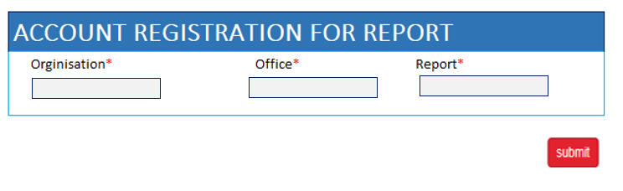
PRODUCTION REPORT

Slide 5
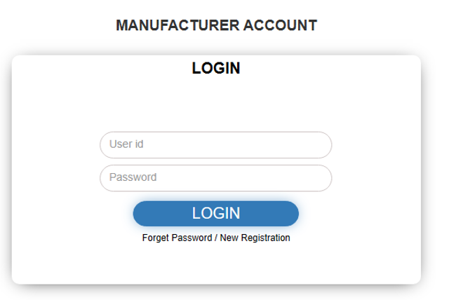
Login to Manufacturer Account

Slide 6
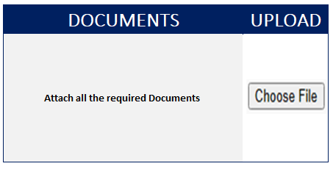
For New License
Management
District Office
Divisional Office
DG E&T Punjab Office

Slide 7
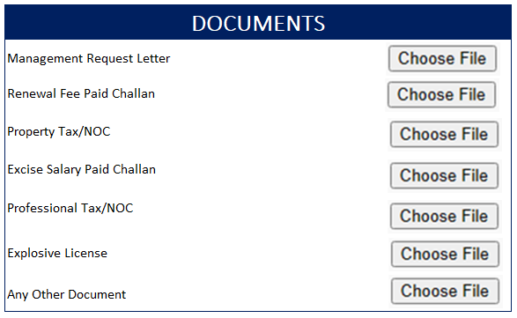
Renewal Request - Distillery
License Renewal
ETO
DIRECTOR E&T

Slide 8

REPORT SECTION
REPORT
Nature: |  | Select
 |  | 1. Production > | * Anhydrous | ________________
 |  |  | * Rectified | _______________
 |  |  | * Low Grade | ________________
 |  | 2. Consumption | Molasses | ___________M.Tons
 |  |  | If Any Other then Name It:_______ | _________________
Basis: |  | Select
 |  | 1. Daily
 |  | 2. Monthly
 |  | 3. Yearly
Attach Document if Any

Slide 9
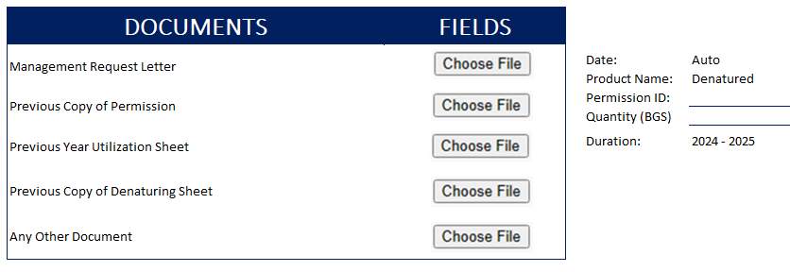
Annual Permission Local – Denaturing
LIST OF DISTILLRIES > | 1. HUNZA SUGAR MILLS (PVT) LTD., & DISTILLERY, Faisalabad
 | 2. NOON SUGAR MILLS LTD., & DISTILLERY, Sargodah
 | 3. CRYSTALLINE CHEMICAL INDUSTRIES, Sargodah
 | 4. RAMZAN SUGAR MILLS LTD., & DISTILLERY, Chiniot
 | 5. MADINA GROUP OF INDUSTRIES, Chiniot
 | 6. TANDLIANWALA SUGAR MILLS LTD., & DISTILLERY, Faisalabad
 | 7. REHMAN HAJRA SUGAR MILLS LTD., & DISTILLERY, M. GARH
 | 8. PREMIER CHEMICAL INDUSTRIAL Mfg. Co. (Pvt.) Ltd. Sheikhupura
 | 9. PAK ETHANOL (PVT) LTD., SADIQABAD
 | 10. RYK DISTILLERY, SADIQABAD
ETO
DIRECTOR E&T
DG E&T

Slide 10
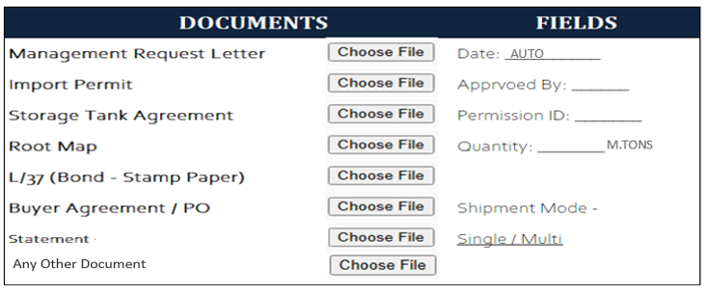
Form L/36– NEW Request
Select > | Bulk |  |  | NATURE: | DENATURED
 | ISO
ETO
DIRECTOR E&T
Storage Tank Agreement will be removed when ISO selected

Slide 11
Form L/36– NEW Request
Select > | Bulk |  |  | NATURE: | RECTIFIED
 | ISO
ETO
DIRECTOR E&T
Storage Tank Agreement will be removed when ISO selected

Slide 12
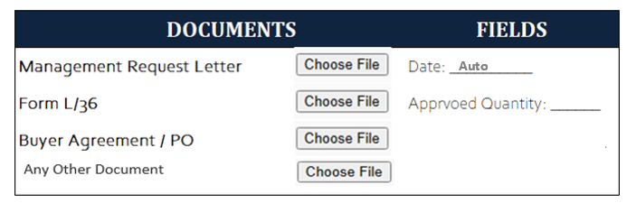
Form L/36– Change Request
Select > | Bulk |  |  | NATURE: | RECTIFIED
 | ISO |  |  |  | DENATURED
No.______
ETO
DIRECTOR E&T

Slide 13

Form L/36– Quantity Cancelation
Select > | Bulk |  |  | NATURE: | RECTIFIED
 | ISO |  |  |  | DENATURED
No.______
ETO
DIRECTOR E&T

Slide 14
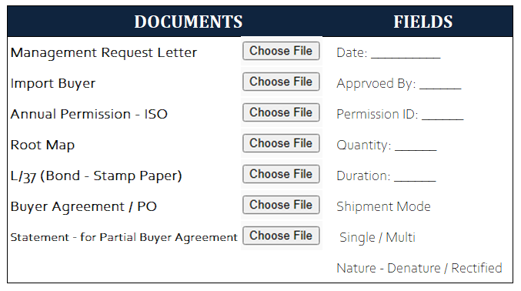

Form L/36 – New Request
Select > | Bulk |  |  | NATURE: | RECTIFIED
 | ISO |  |  |  | DENATURED
Inspector E&T
ETO
DIRECTOR E&T
NOTE: REMOVED DUE ALREADY SLIDE 10 & 11

Slide 15
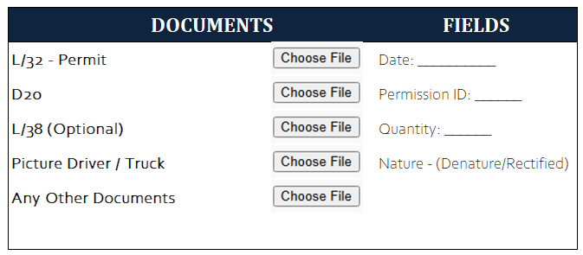
Material Dispatch - Local
No.______
Type of License ______________
S/No.______
S/No.______
/Litters
Vehicle
Forwarded To Inspector E&T

Slide 16
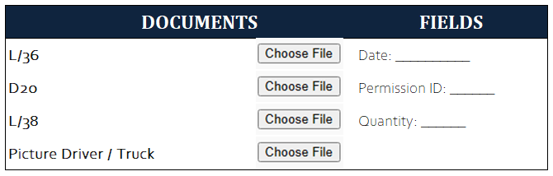
Material Dispatch - Export
No.______
S/No.____
S/No.______
Vehicle
If Denatured then name of Chemical and Proportion: ___________

Slide 17
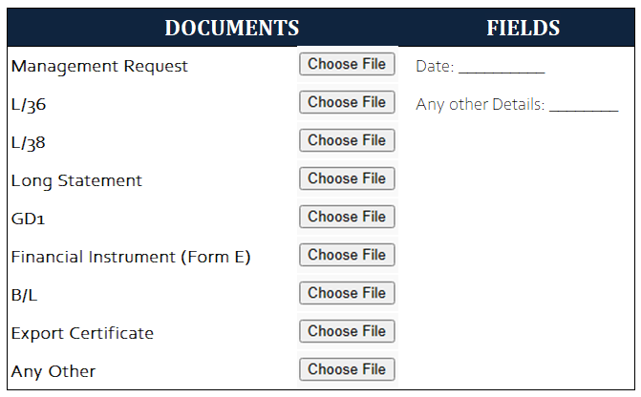
Request for Release Bond - Bulk
No.______
Auto
No.______
Nos._____
Attach Shipping Document
Export Certificate
If Denatured then name of Chemical and Proportion: ___________

Slide 18
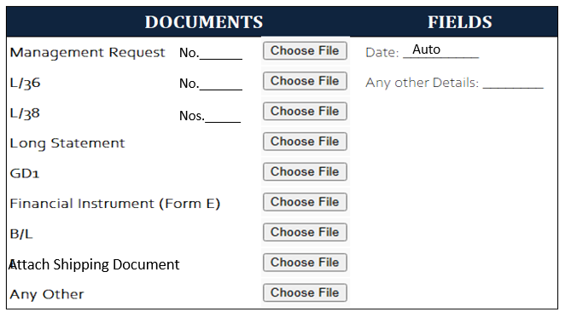
Request for Release Bond - ISO
Select > | Bulk |  |  | NATURE: | RECTIFIED
 | ISO |  |  |  | DENATURED
Remove
Shipping Doc will be removed if Denatured will be selected

Slide 19
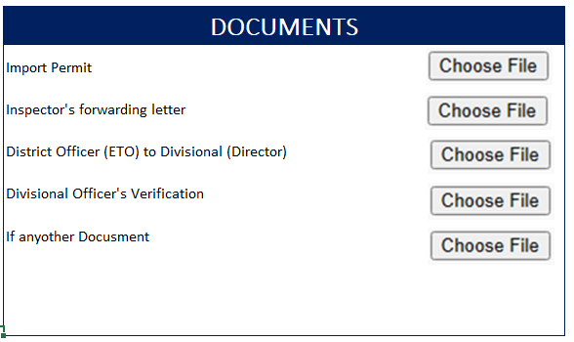
Permit Verification From other Province
No.
Name of Province

